Slide 1
Modeling GPU non-Coalesced Memory Access
Michael Fruchtman

Slide 2
Importance
GPU Energy Efficiency
Dependent on performance
Complex Memory Model
Coalesced memory
Warps of 16 threads
Applications
Memory bound applications
Predict the performance

Slide 3
Goals
Profile the effect of non-coalesced memory access on memory bound GPU applications.
Find a model that matches the delay in performance.
Extend the model to calculate the extra cost in power.

Slide 4
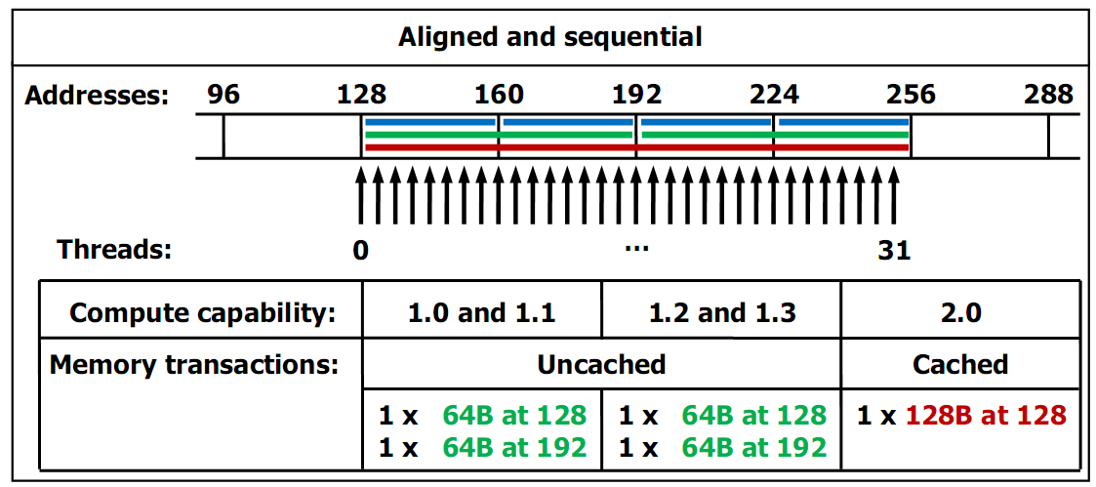
Coalesced Access
Source: Cuda Programming Guide 3.0

Slide 5
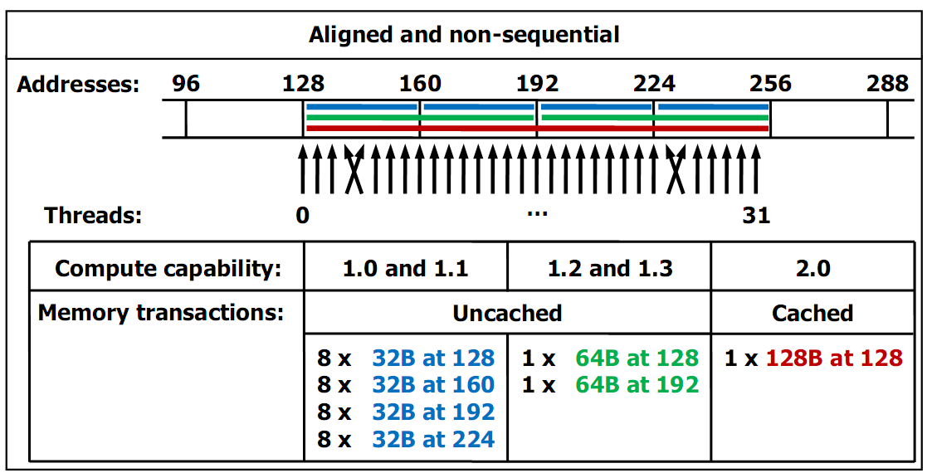
Coalesced Access
Source: CUDA Programming Guide

Slide 6
Method and Procedure
Find a memory bound problem
Matrix/Vector Addition
8000x8000
Perform a solution for each level of coalescence
16 levels of coalescence
Separate threads from each other
Increasing number of memory accesses
Same number of instructions
Increasing memory access time

Slide 7
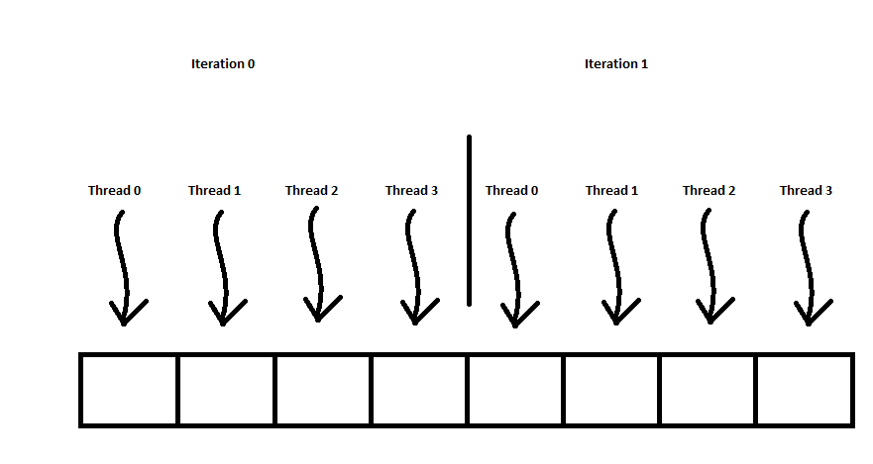
Perfect Coalescence
Block Striding

Slide 8
Example Code
__global__ void matrixAdd(int * A, int * B, int * C, int matrixSize)
{
int startingaddress = blockDim.x * blockIdx.x + threadIdx.x;
int stride = blockDim.x;
for(int currentaddress=startingaddress; currentaddress < matrixSize; currentaddress+=stride)
{
C[currentaddress]=A[currentaddress]+B[currentaddress];
}
}

Slide 9
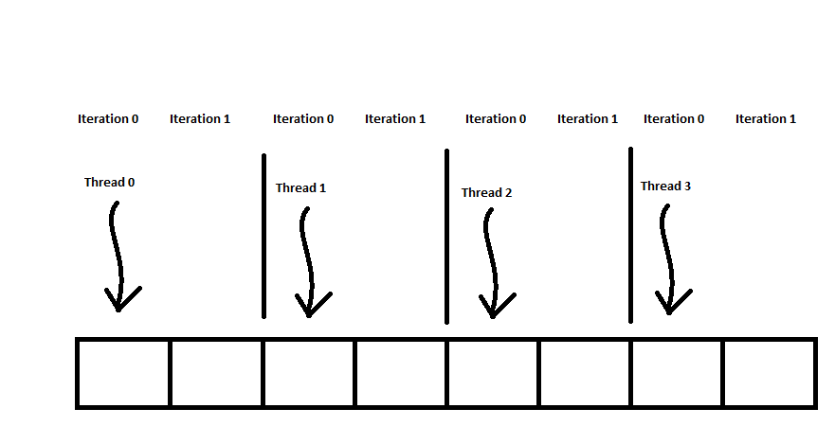
Perfect Non-Coalescence
Stream Splitting

Slide 10
Example Code
__global__ void matrixAdd(int * A, int * B, int * C, int matrixSize)
{
int countperthread = matrixSize/blockDim.x;
int startingaddress=((float)threadIdx.x/blockDim.x)*matrixSize;
int endingaddress = startingaddress+countperthread;
for(int currentaddress=startingaddress; currentaddress<endingaddress; currentaddress++)
{
C[currentaddress]=A[currentaddress]+B[currentaddress];
}
}

Slide 11
Non-Coalesced Level
Modify Perfect Coalescence Code
Read the stride from the matrix
Insert 0s at the right places to stop threads
Instruction Number
Slight Increase
Memory access becomes increasingly non-coalesced
Doesn’t perform perfect matrix addition

Slide 12
Experimental Setup
Nehalem Processor
Core i7 920 2.6GHz
Performance metric included memory transfer
QPI improves memory transfer performance compared to previous architecture such as Core 2 Duo

Slide 13
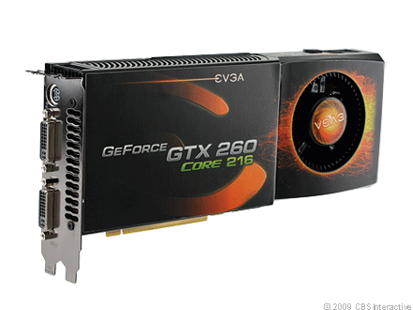
Experimental Setup
NVIDIA CUDA GPU
EVGA GTX 260 Core 216 896MB
GT200, CUDA Version 1.3 supports partial coalescence
Stock speed 576MHz
Maximum Memory Bandwidth 111.9GB/s
216 cores in 27 multiprocessors

Slide 14
Performance

Slide 15
Memory Requested (bytes)

Slide 16
Instructions Executed

Slide 17
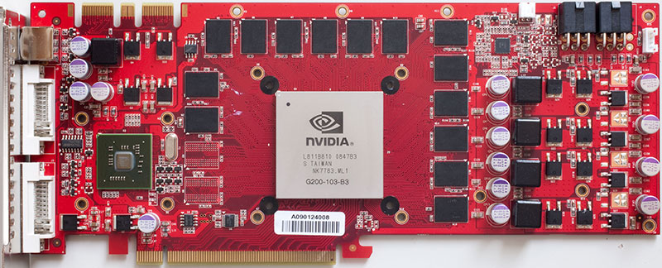
Performance Mystery
Why is perfect non-coalescence so much slower than 1/16 coalescence?
NVIDIA GTX 260 216

Slide 18
Non-Coalescence Model
Performance is near perfectly linear
R² = 0.9966
D(d) =d * M_{a}
d: number of non-coalesced memory accesses
M_{a}: Memory access time
Dependent on memory architecture
GT200 M_{a}= 2.43 microseconds measured
1400 clock cycles

Slide 19
Model of Extra Power Cost
Power consumption is in a range
Dependent on GPU
See An Integrated GPU power and performance model
P(d) = D(d) * P(d)
D(d) is delay due to non-coalesced access
P(d) is the average power consumed by GPU while active

Slide 20
Conclusion
Performance Degrades Linearly with non-coalesced access
Energy efficiency will also degrade linearly
Memory-bound applications
GPU Memory Contention
Switching time between chip significant
Tools to reduce non-coalescence
CUDA-Lite finds and fixes some non-coalesence

Slide 21
References and Related Work
NVIDIA. NVIDIA CUDA Programming Guide 3.0. February 20, 2010.
S. Baghsorkhi, M. Delahaye, S. Patel, W. Gropp, W. Hwu. An adaptive performance modeling tool for GPU Architectures. Proceedings of the 15th ACM SIGPLAN symposium on Principles and practice of parallel programming. Volume 45, Issue 5, May 2010.
S. Hong and H. Kim. An integrated GPU power and performance model. Proceedings of the 37th annual international symposium on computer architecture. Volume 38, Issue 3, June 2010.
S. Lee, S. Min, R. Eigenmann. OpenMP to GPGPU: a compiler framework for automatic translation and optimization. Proceedings of the 14th ACM SIGPLAN symposium on Principles and Practice of parallel programming. Volume 44, Issue 4, April 2009.
S. Ueng, M. Lathara, S. Baghsorkhi, W. Hwu. CUDA-Lite: Reducing GPU Programming Complexity. Languages and Compilers for Parallel Computing. Volume 5335, pp. 1-15. 2008.

